Slide 1
DESIGN AND IMPLEMENTATION OF A WEARABLE EAR-EEG SYSTEM WITH SpO2 AND TEMPERATURE MONITORING FOR BRAIN ACTIVITY ASSESSMENT
Student Names: Parasuraman M| Sudharsan S | Tharun s
Guide Name: Dr. K.KARTHIKA
Department: Electronics and Communication Engineering
Date: 23 March 2026

Slide 2
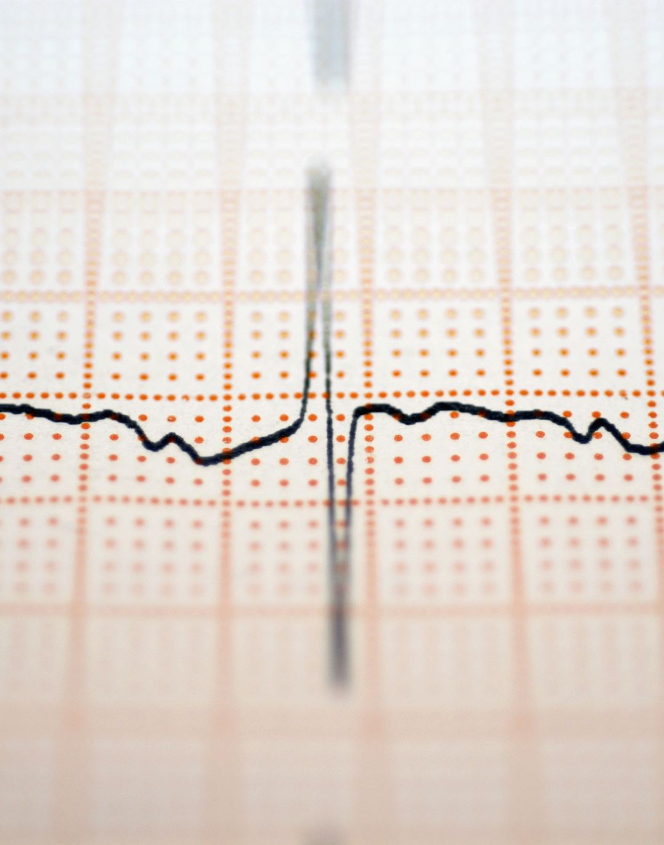
ABSTRACT
Brief Overview: This project proposes a low-cost wearable in-ear EEG system integrated with SpO2, heart rate, and ear canal temperature sensors for real-time brain activity monitoring. Dry-contact electrodes placed inside the ear canal acquire EEG signals, which are processed using an embedded microcontroller to classify brain states such as Awake, Drowsy, and Sleep onset in ambulatory settings.

Slide 3
OBJECTIVE &SCOPE
Objective: To design and implement a multimodal wearable ear-EEG device that combines neural and physiological parameters for accurate, continuous, and non-invasive brain state assessment outside clinical environments.
Scope: The system targets drowsiness detection, sleep monitoring, and cognitive fatigue assessment using Arduino-based embedded hardware with Bluetooth wireless connectivity and mobile display.

Slide 4
INTRODUCTION
Background and Motivation
The brain produces continuous electrical signals representing cognitive states (attention, sleep, stress).
Problem Statement
Existing ear-EEG systems monitor only EEG signals (single parameter).
Can a low-cost, multimodal wearable ear-EEG system integrating SpO2, heart rate, and ear canal temperature provide reliable real-time brain activity monitoring suitable for ambulatory use?
Research Question
Electroencephalography (EEG) is used to record these signals.
Traditional scalp EEG requires clinical setup and trained personnel.
It is not suitable for daily or ambulatory use.
In-ear EEG uses ear canal electrodes, offering stable, real-world brain monitoring.
They lack integration with other physiological signals (SpO₂, heart rate, temperature).
Systems are expensive and laboratory-grade.
Require wired amplifiers, limiting portability.
Single-parameter monitoring reduces accuracy and reliability of brain state classification.

Slide 5
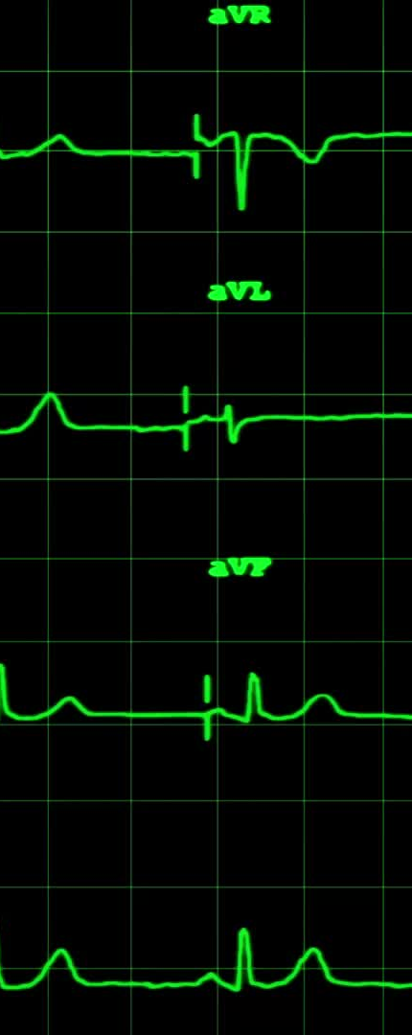
BASE PAPER
Title: Ear-EEG Devices for the Assessment of Brain Activity: A Review
Source: IEEE Sensors Journal, Vol. 24, No. 20 (DOI: 10.1109/JSEN.2024.3415668)
Key Focus: First comprehensive PRISMA-based systematic review of 96 in-ear EEG studies across six thematic categories.
Highlights:96 papers reviewed (2011–2023); rapid growth observed post-2016
Six categories: sensor design (32), BCI (26), sleep (21), ERPs (10), epilepsy (4), computational modeling (3)
Key gap: no standard montage or validation protocol across studies
Authors: Juez, J.Y. | Moumane, H. | Nassar, M. | Molina-Salcedo, I. | Segura-Quijano, F.E. |
Year: 2024

Slide 6
LITERATURE SURVEY
S.NO | Project title and source | Key focus | Highlights | Author | Year
1 | Brain Wearables: Validation Toolkit for Ear-Level EEG Sensors | Development of a hardware-to-signal validation toolkit for ear-EEG devices including 3D-printed ear phantom and EaR-P Lab software with 9 EEG paradigms. | First ear-canal specific EEG phantom developed. 9 EEG paradigms validated (alpha, ASSR, SSVEP, AEP, VEP, MMN, P300, EOG). Uses LSL protocol | Correia, G. Crosse, M.J. Lopez Valdes, A. | 2024
2 | Signal Quality Evaluation of an In-Ear EEG Device in Comparison to a Conventional Cap System | Signal quality validation of a dry-contact in-ear EEG device vs 64-channel wet scalp EEG during wakefulness and sleep in 30 healthy subjects. | 93% subjects show strong alpha correlation Scalp amplitude ~2× higher; N3 correlation = 0.62 4 dry electrodes; 250 Hz, 24-bit, Bluetooth | Moumane, H, Pazuelo, J, Nassar, M , Juez, J.Y, Valderrama, M, Le Van Quyen, M. | 2024
3 | Evaluating the Electroencephalographic Signal Quality of an In-Ear Wearable Device | Independent validation of a commercial dry-contact in-ear EEG device (NAOX Technologies) against gold-standard wet scalp EEG across wakefulness, sleep, and motion conditions. | Correlation: 0.87 (alpha/artifacts), 0.76 (alpha), 0.52 (sleep waves) Alpha power shows no significant difference | Pazuelo, J. Juez, J.Y. Moumane, H. Pyrzowski, J. Valderrama, M. Le Van Quyen, M. | 2024

Slide 7
LITERATURE SURVEY
S.NO | Project title and source | Key focus | Highlights | Author | Year
4 | Automatic Detection of Drowsiness Using In-Ear EEG | First proof-of-concept study classifying drowsiness (Wake vs NREM Stage 1) using in-ear EEG with complexity-based features and binary SVM on 23 subjects. | Drowsiness accuracy: 80–82.9% (ear-EEG) vs 86.8–88.8% (scalp) Alpha power decreases in NREM1 (consistent with scalp EEG) Kappa: 0.53–0.60 Uses generic viscoelastic earpiece | Nakamura, T. Alqurashi, Y.D. Morrell, M.J. Mandic, D.P. | 2018
5 | Real-Time EEG-Based Drowsiness Detection Using Deep Learning Algorithms | Review of complete EEG-based drowsiness detection pipeline emphasising deep learning classification for real-time wearable deployment | Drowsiness: ↑ theta, ↑ alpha, ↓ beta CNN → spatial features; LSTM → temporal patterns Hybrid CNN-LSTM outperforms CNN, SVM, k-NN Edge AI + embedded systems enable real-time use Multimodal fusion improves accuracy | Suman, J.V, Nurmatovich, H.A, Rajulu, B.G, Shadiyor, Y, Chakravarthi, P.K. | 2025

Slide 8
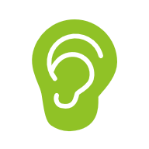
Description of Research Gap
Based on the survey of existing ear-EEG systems, current solutions such as the Mobita TMSi EEG amplifier, OpenBCI, and WANDmini platforms are used for brain activity monitoring. These systems record EEG signals from in-ear electrodes and have been validated for drowsiness detection, sleep staging, and brain-computer interface applications. However, existing systems monitor only EEG signals and do not integrate any additional physiological parameters such as SpO2 or body temperature. Furthermore, these systems are expensive, laboratory-grade, and require wired connections to external amplifiers. They are not designed for ambulatory or daily-life use and cannot be deployed as standalone IoT devices. The lack of multimodal sensing and real-time wireless monitoring limits the reliability and practical applicability of these systems for continuous brain state assessment outside clinical environments.

Slide 9
RESEARCH GAP IDENTIFIED
Research Gap | Our Solution
EEG only — no physiological parameters | Added MAX30102 (SpO2 + Heart Rate) and MLX90614 (Temperature)
Expensive laboratory-grade systems | Low-cost Arduino-based embedded system
Wired connections to amplifiers | Wireless Bluetooth / WiFi IoT connectivity
Not suitable for ambulatory use | Compact wearable design for daily use
Single-parameter brain classification | Multimodal classification using EEG + SpO2 + Temperature
Validated only on healthy subjects | Designed for general ambulatory population

Slide 10
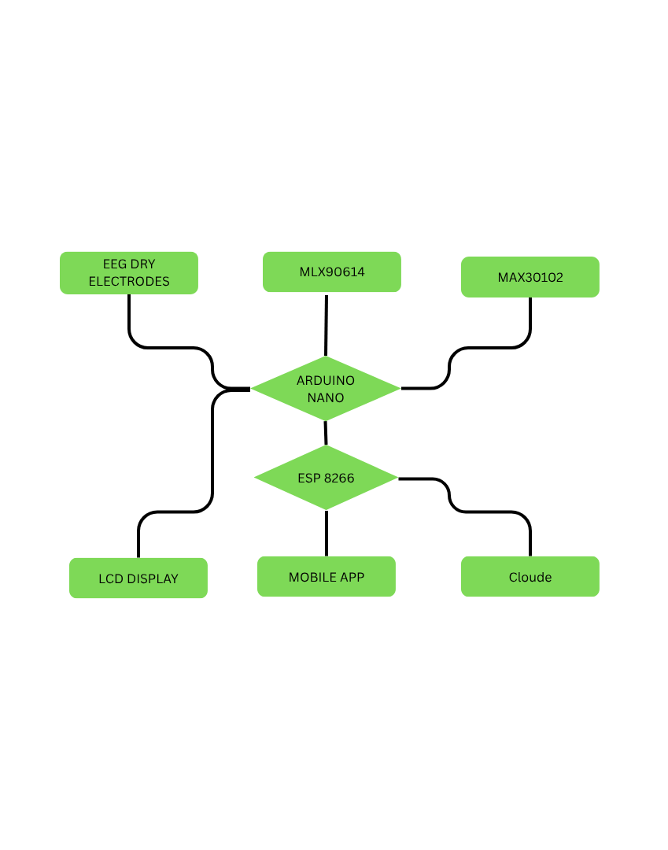
METHODOLOGY
Dry Ag/AgCl electrodes capture EEG signals, amplified using INA128 and filtered (0.5–50 Hz).
MAX30102 sensor measures SpO₂ and heart rate; MLX90614 measures temperature via I2C.
FFT processing extracts Alpha (8–13 Hz) and Theta (4–8 Hz) EEG bands.
Brain state is classified using EEG + SpO₂ + heart rate + temperature.
Output shown on 16×2 LCD and transmitted via HC-05 Bluetooth to mobile app.

Slide 11
Brain State Classification Table
EEG Band | SpO2 | Heart Rate | Temperature | Brain State
Alpha dominant | Normal >95% | Normal | Normal | Relaxed Awake
Theta dominant | Slight drop | Slowing | Slight rise | Drowsy
Delta dominant | Low <92% | Slow | Elevated | Sleep Onset

Slide 12
REFERENCES
J. Y. Juez et al., "Ear-EEG Devices for the Assessment of Brain Activity: A Review," IEEE Sensors Journal, vol. 24, no. 20, pp. 31606–31623, Oct. 2024.
H. Moumane et al., "Signal Quality Evaluation of an In-Ear EEG Device in Comparison to a Conventional Cap System," Frontiers in Neuroscience, vol. 18, Sep. 2024.
Y. R. Tabar et al., "At-Home Sleep Monitoring Using Generic Ear-EEG," Frontiers in Neuroscience, vol. 17, Feb. 2023.
S. L. Kappel et al., "Dry-Contact Electrode Ear-EEG," IEEE Transactions on Biomedical Engineering, vol. 66, no. 1, pp. 150–158, Jan. 2019.
A. Paul et al., "A Versatile In-Ear Biosensing System and Body-Area Network for Unobtrusive Continuous Health Monitoring," IEEE Transactions on Biomedical Circuits and Systems, vol. 17, no. 3, Jun. 2023

